Slide 1
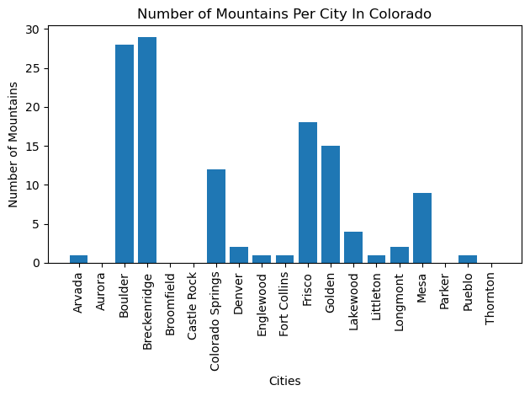
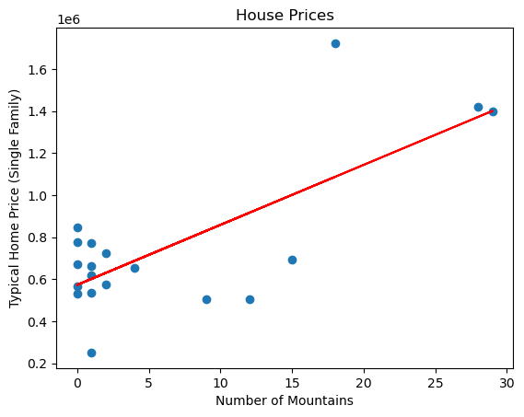
Mountains Data
-
-Wanted to see if having more mountains in a city meant more expensive homes in the city.
-Figured out how many mountains are in each city and typical home prices in each city. (Bar Graph)
-Compared typical home prices to number of mountains in the city . (Scatter Plot)
-Had a radius of 10 km because mountains wouldn’t be right in a city, they would be surrounding the city.
-Found that there is a very strong correlation between the number of mountains and the home price. The R value was .76 which means there is a 76% chance that the value of homes increases based on the number of mountains.

